Slide 1
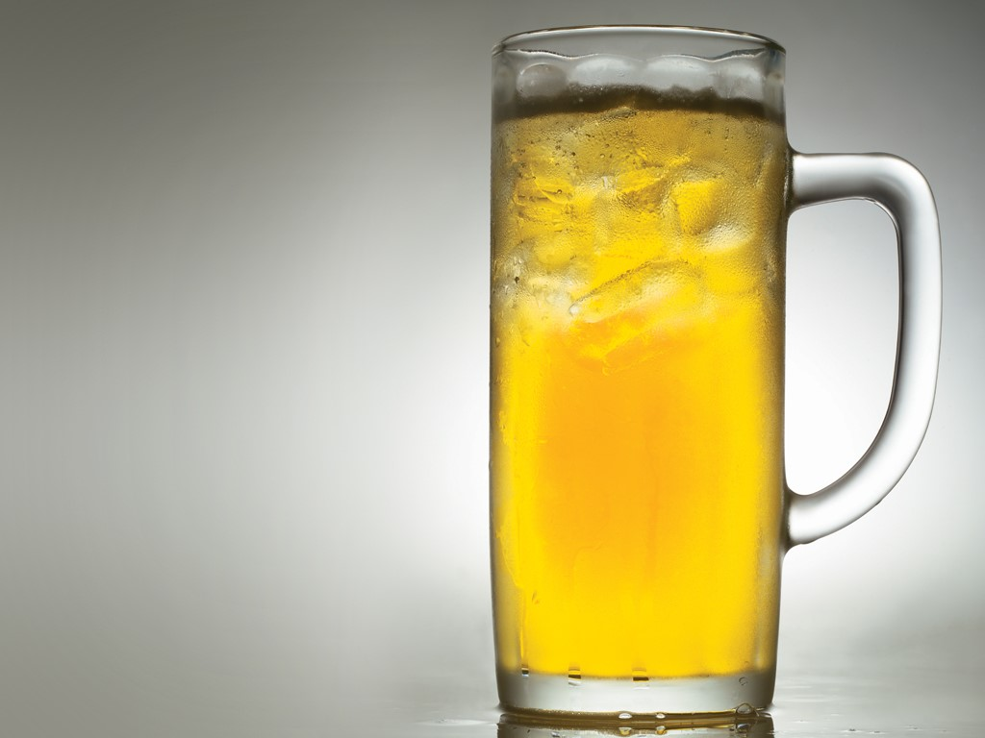
Southwest Conquistador Case
Hoya Team 1
Christian L’Heureux
Alina Degtyareva
Aaron Packard-Winkler
Vicente Amengual
Connor Ginsberg
Sneha Paul

Slide 2
Market Research Reports
 | Report name | Selection rationale | Cost
A | National/Oregon per capita beer consumption | Provides data for estimation of average annual per capita beer consumption in Oregon state - for revenue projection | $600
B | Population Estimates | Provides data for population estimates and its growth rate | $900
C | Market Share Estimates | Provides data for estimation of the market share that could be covered | $1,200
D | Estimated Liquor and Beer Licenses | Not useful – We initially wanted it for market sizing and segmentation. It might have provided details on keg vs can/bottle consumption | $600
E | Beer Taxes Paid | Data for gallons sold and market share could be derived from this report | $2,400
F | Financial Statement Summary | Data required for cost of sales projections; operating expenses benchmark | $100
I | Retail & Wholesale Prices | Data for six pack pricing decision | $3,600
 |  | Total | $9,400

Slide 3
Recommendation
Model assumptions:
Discount rate is 8%
COGS is 70%
Price/Six pack $ 3.18
No additional CapEx or changes to working capital (besides initial investment) required
Market share starts at 5% and grows 2% annually (Disregards the reports estimates)
We DO NOT recommend the project because:
Project NPV is negative: $1,341,003
The sensitivity analysis reveals that a positive NPV would happen at:
$7.01 at a 5% yr 1 market share
$3.18 at a 17.85% yr 1 market share
The model is highly sensitive to COGS as well. (Even with COGS at 50%, NPV is negative)

Slide 4
Improving the model
Our model would benefit from primary reports addressing the following information:
Market share of existing beer products
The initial 22% market share we received seems very optimistic
COGS specific to Beer (excluding Wine & Liquor)
The report we bought does not separate the COGS between those three product categories
Elasticity of demand of our products
Model is highly sensitive to price but does not account for inverse relationship to market share
Demographics in Oregon
Our products are particularly famous with Hispanics
Market segmentation of kegs and six-packs
Case states that kegs are sold in significant discount to six-pack
Actual population of all counties in Oregon
There are 36 counties in Oregon and we received data for only 5
Cost of transportation and distribution
Customer Lifetime Value

Slide 5
Modified model
Our decision would be different if:
Target one third of the total population of Oregon vs. only 5 counties
Assume initial 5% market share
8% discount rate

